Slide 1

Weather Analysis

Slide 2

INTRODUCTION
In a world where weather patterns impact countless aspects of our daily lives, understanding and analyzing weather data becomes increasingly crucial. The Weather Analysis Project dives into the intricate details of weather phenomena, exploring how factors such as temperature, humidity, pressure, wind speed, and direction affect different regions. Through data visualization and analysis, this project aims to provide valuable insights for various stakeholders, including meteorologists, urban planners, and individuals interested in understanding and preparing for weather fluctuations.

Slide 3
Index
Introduction
ER Diagram
Power BI Questions
EDA Questions

Slide 4
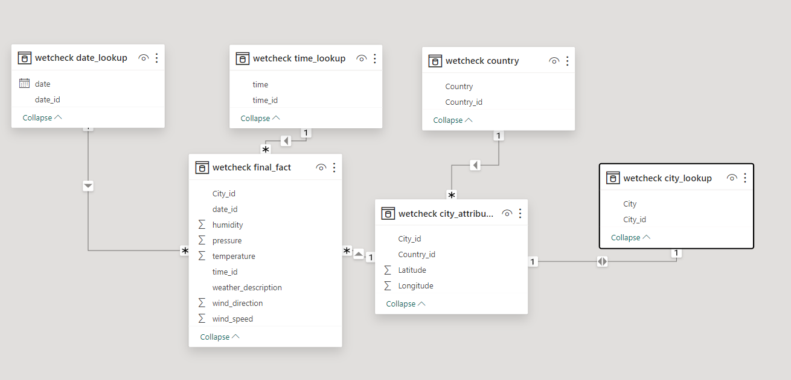
ER Digram

Slide 5
Power BI questions

Slide 6
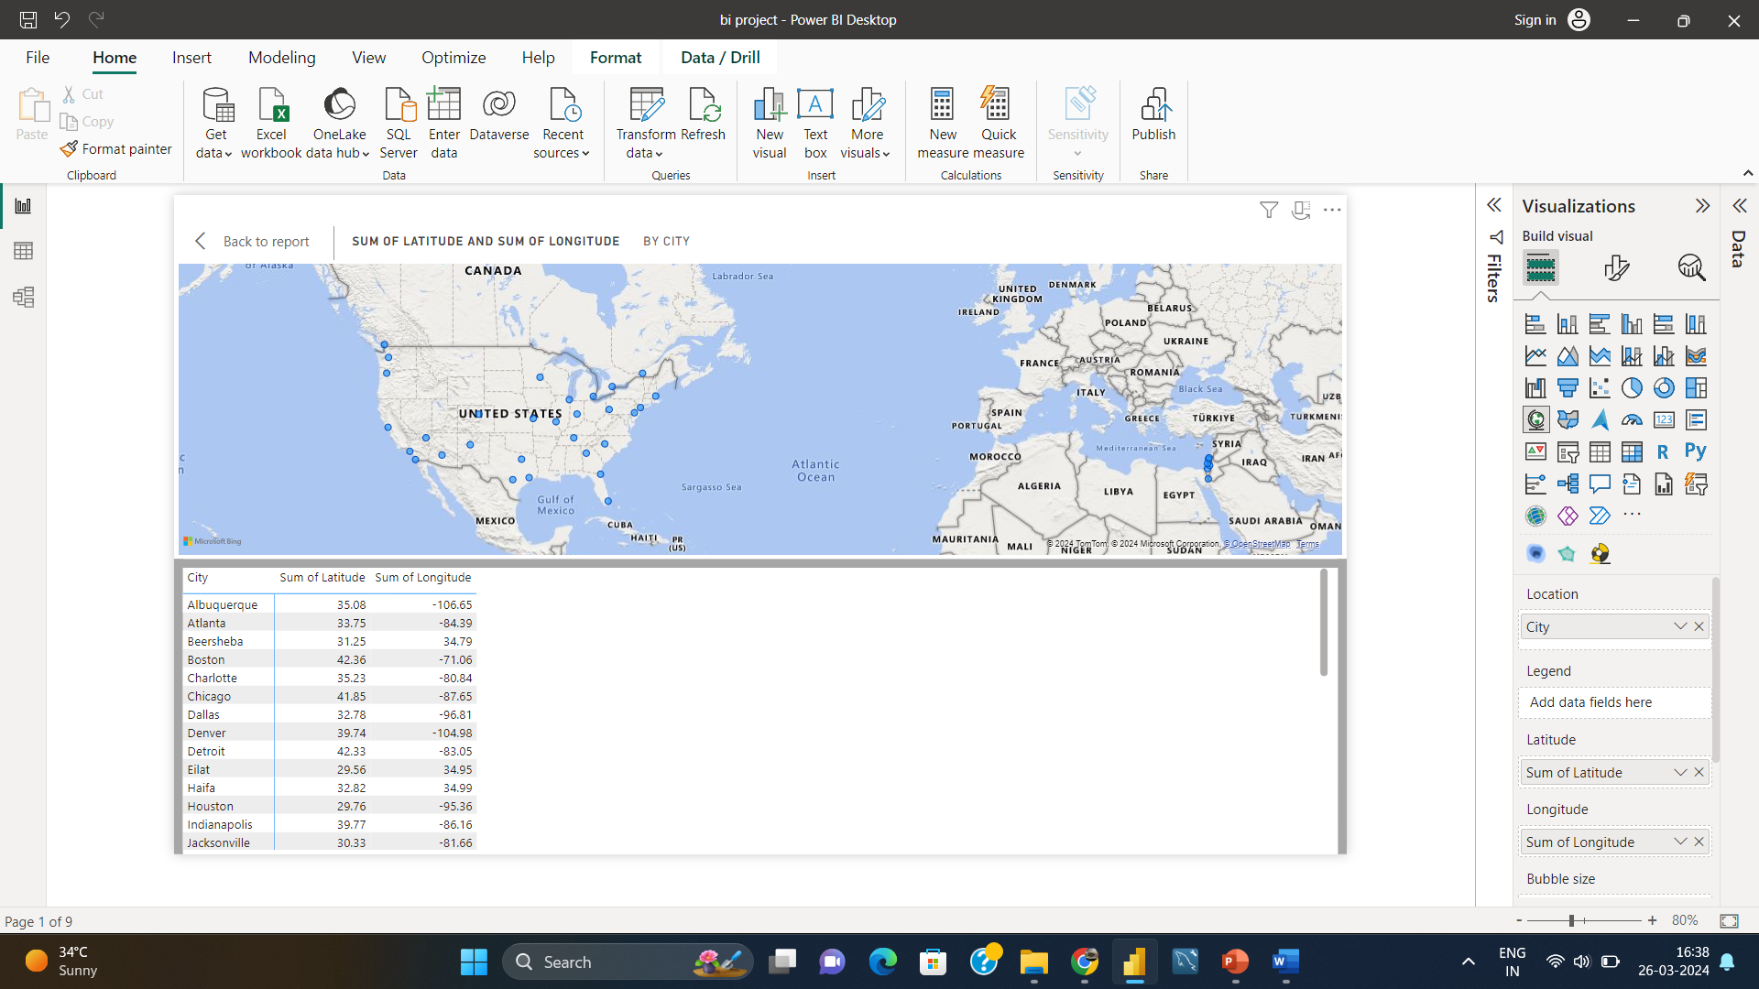
Q1:- Can you create a geographical map in Power BI showing the distribution of cities in the dataset based on their latitude and longitude?

Slide 7
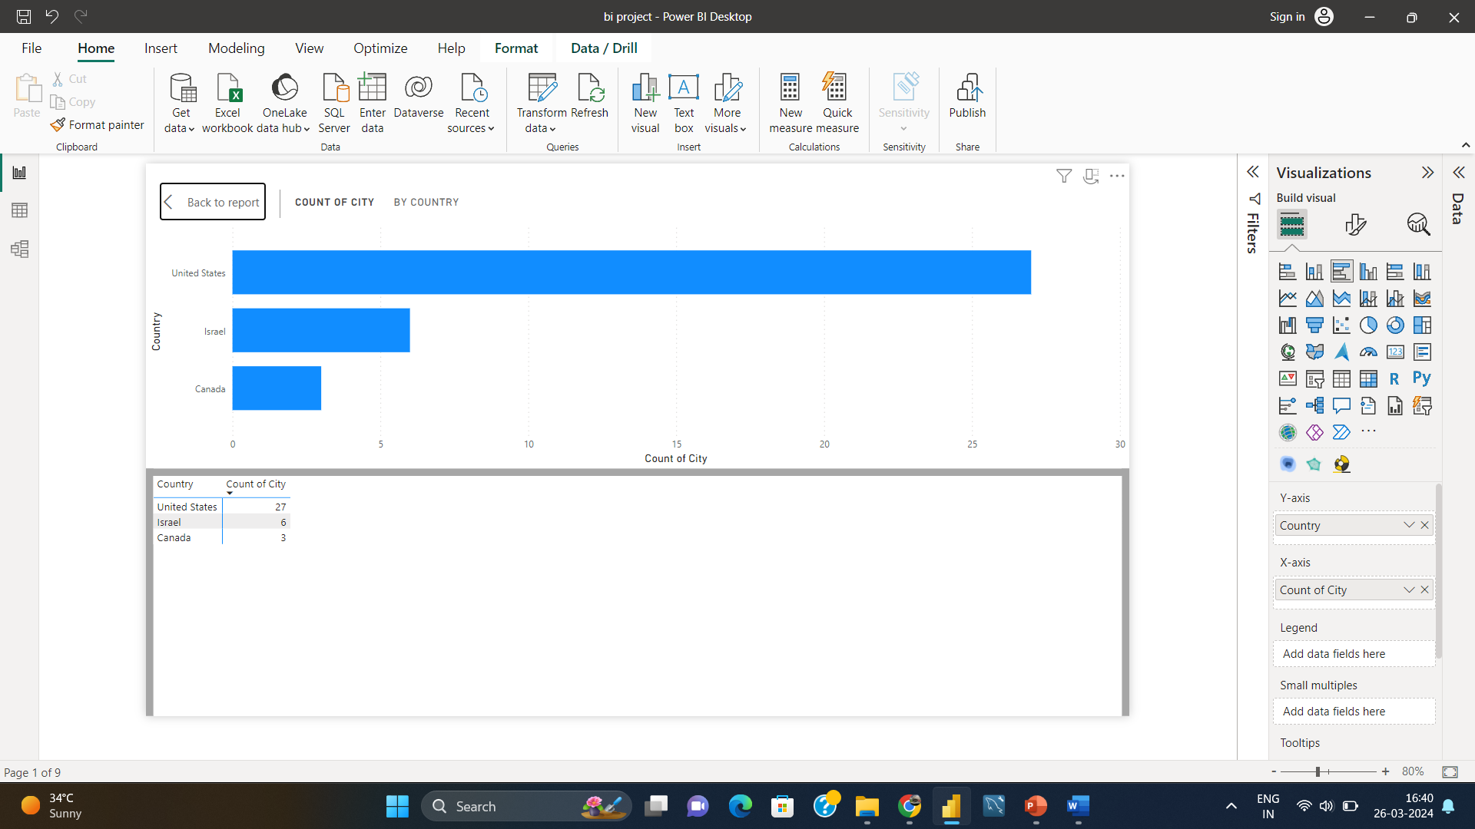
Q2:-In Power BI, can you create a bar chart representing the top 10 countries with the highest number of cities in the dataset?

Slide 8
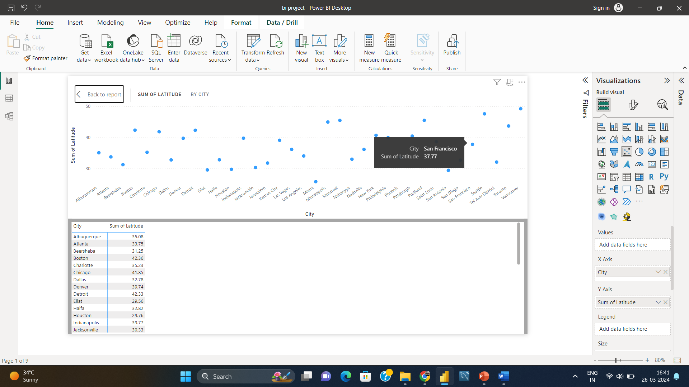
Q3:-How does the distribution of cities in terms of latitude vary across different continents? Create a scatter plot in Power BI to illustrate this.

Slide 9
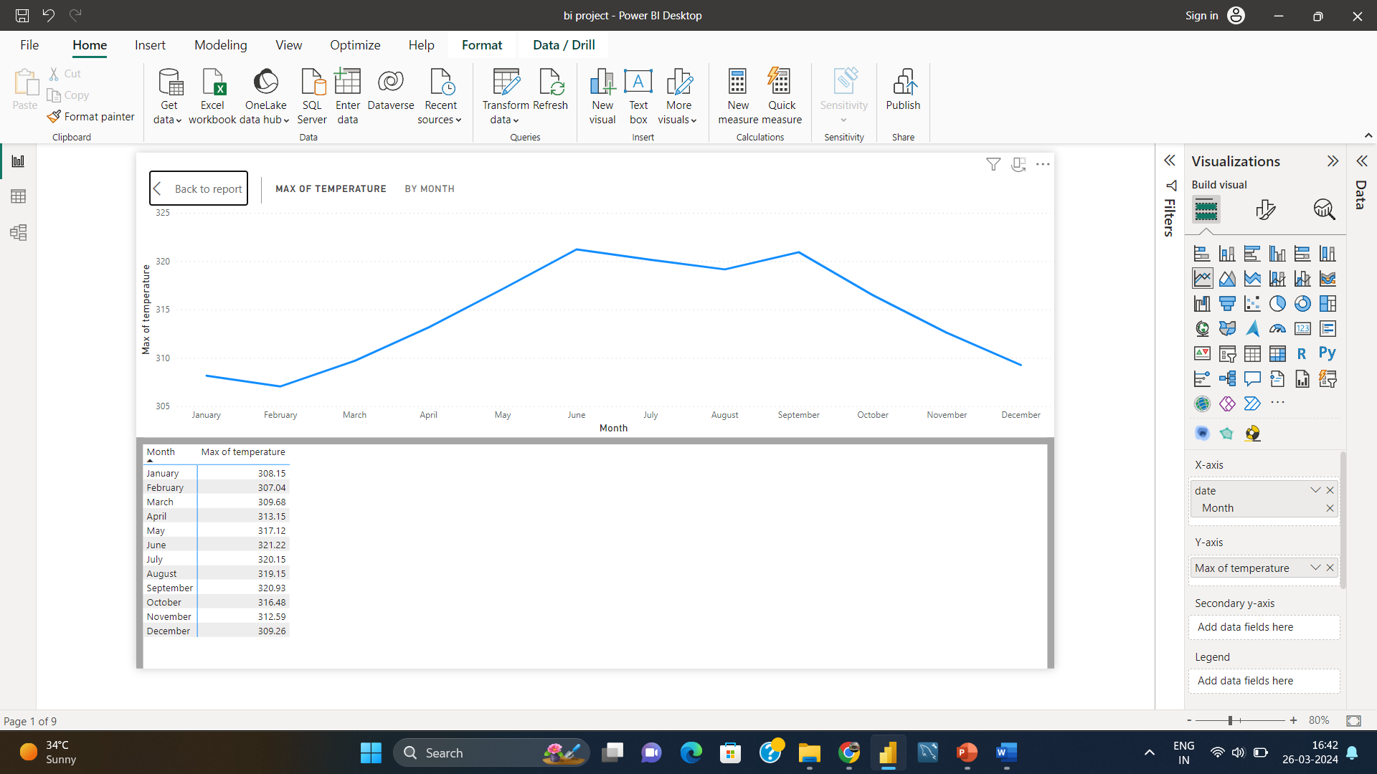
Q4:-Create a line chart in Power BI to display the temperature trends over time for a selected city. Highlight extreme temperature events.

Slide 10
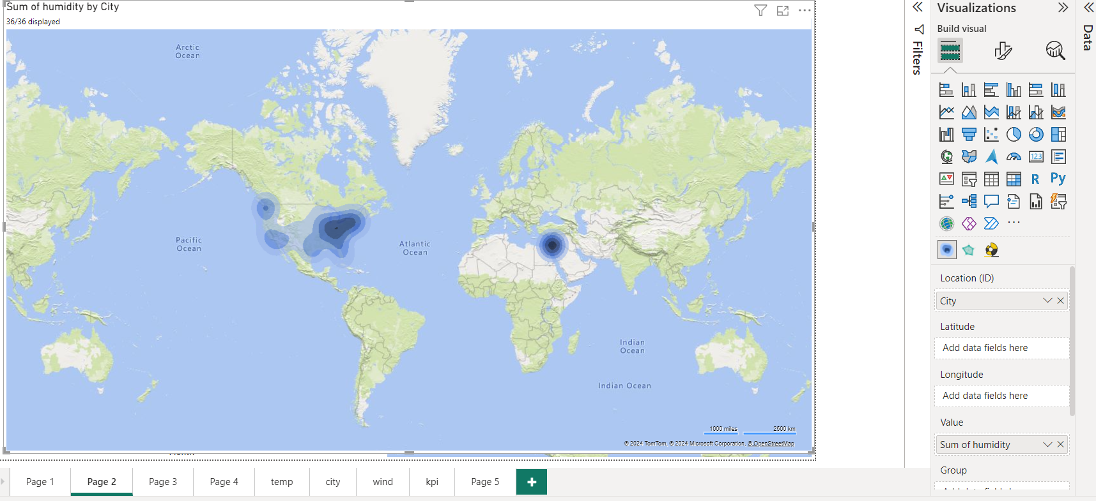
Q5:-How does humidity vary across different cities? Generate a heatmap in Power BI to visualize this variation

Slide 11
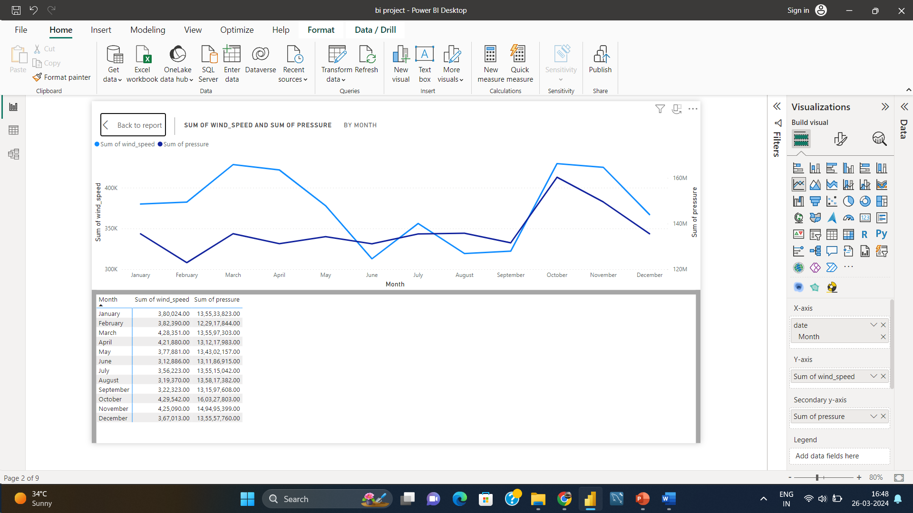
Q6:-Can you create a time-series chart in Power BI showing the relationship between wind speed and air pressure for a specific city?

Slide 12

Q7:-Create a time-series line chart in Power BI to show the overall temperature trends over the entire dataset.

Slide 13
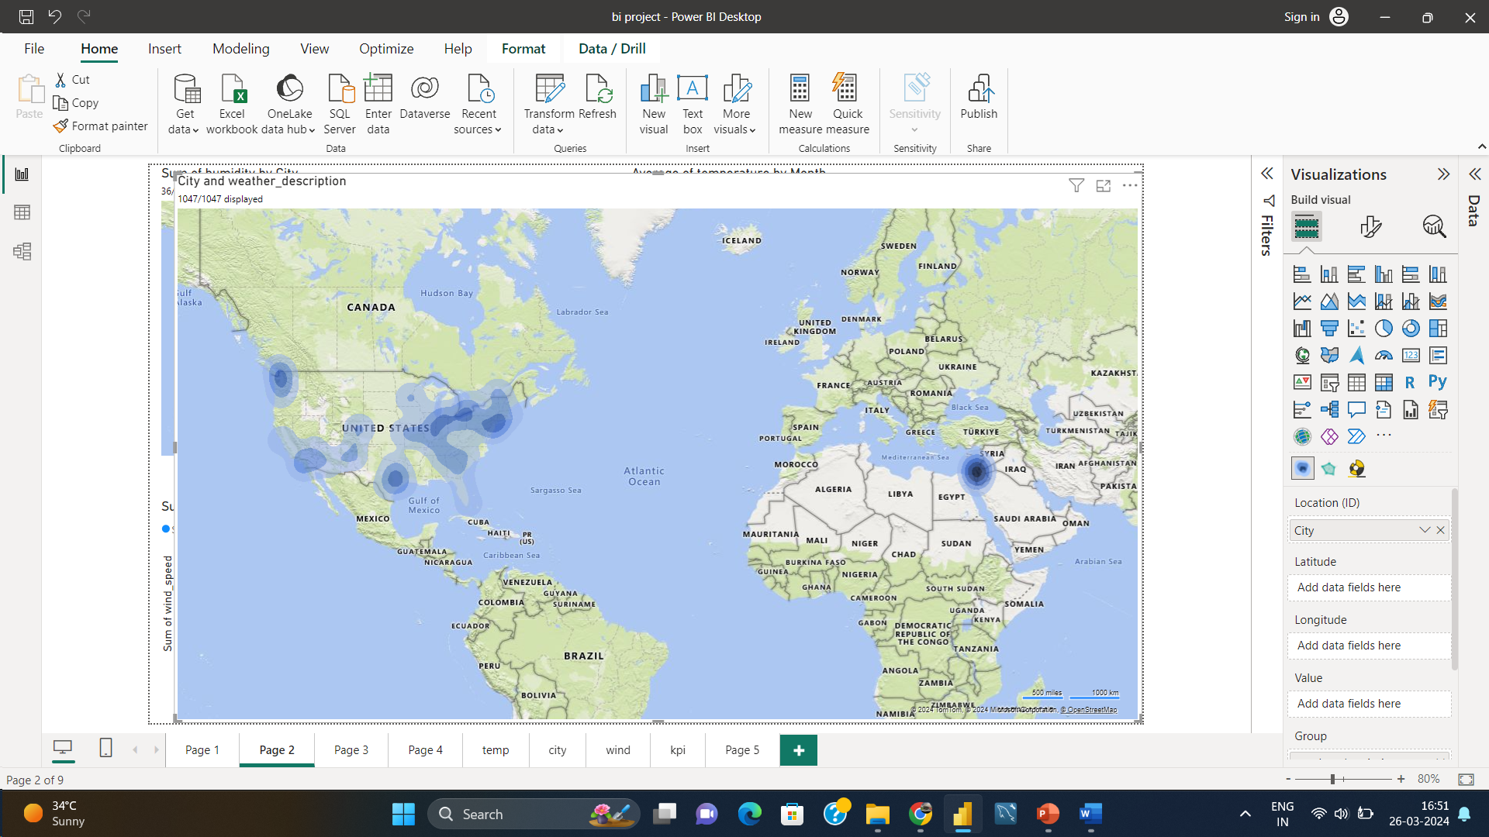
Q8:-Can you create a heatmap in Power BI to visualize the busiest hours for specific weather conditions (e.g., "clear sky," "rainy")?

Slide 14
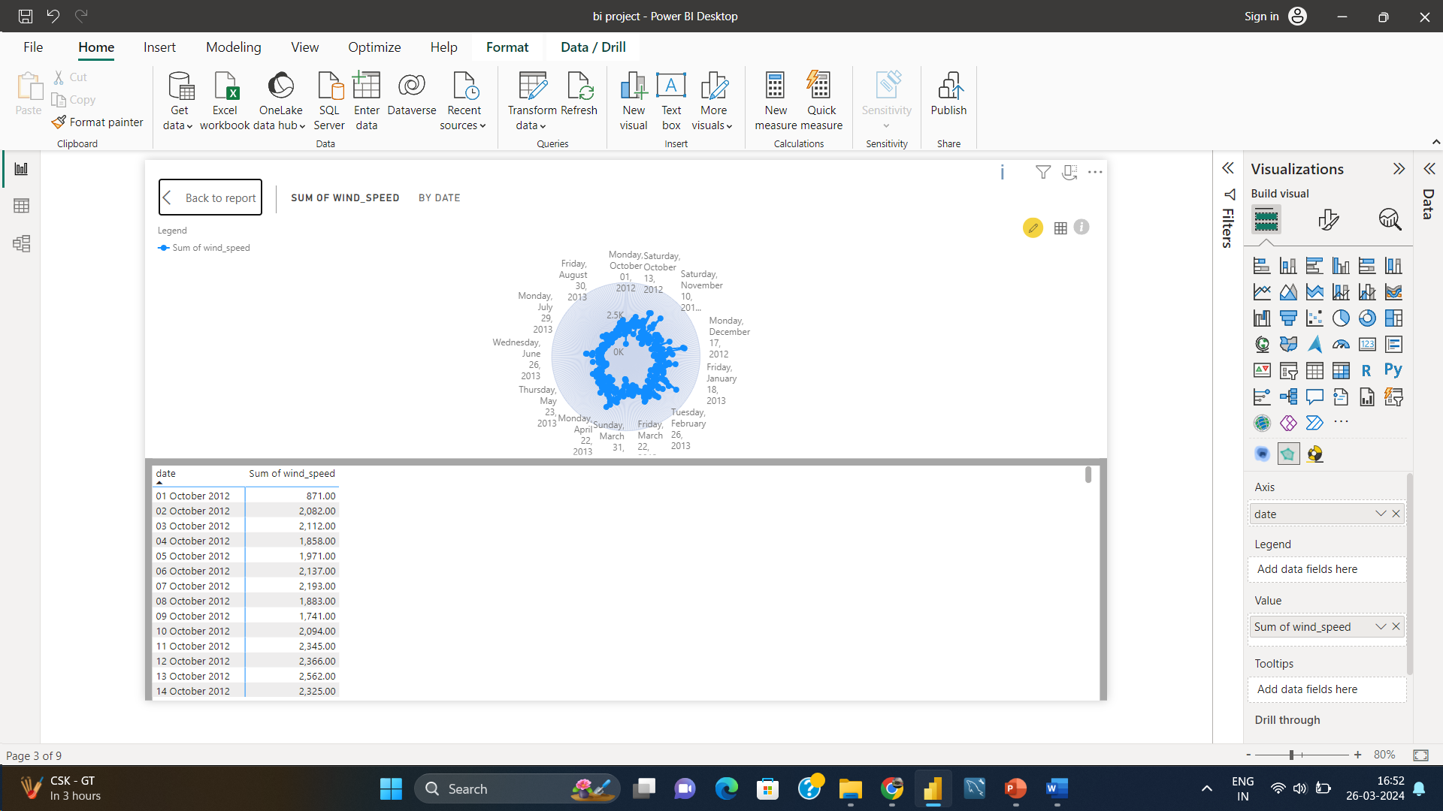
Q9:-How does the wind speed change over the course of a day? Create a radial chart in Power BI to represent this.

Slide 15
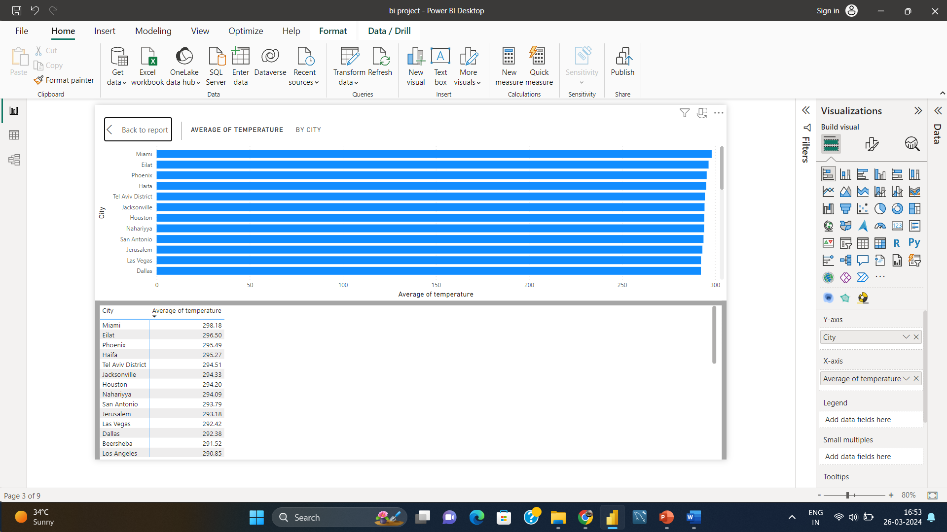
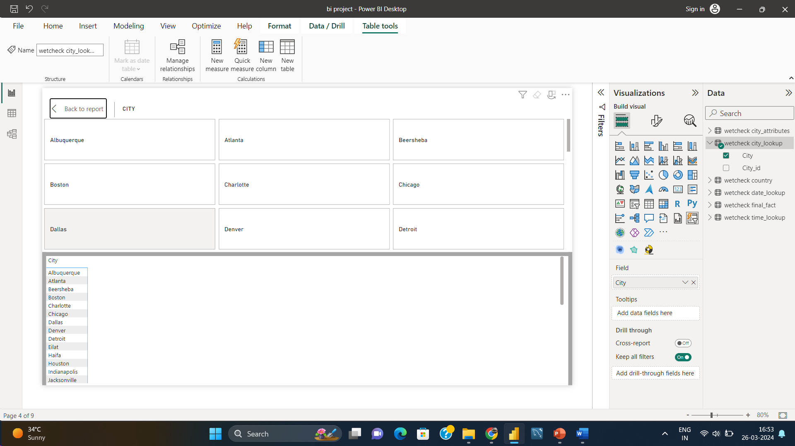
Q10:-Create a Power BI chart comparing the temperature variations between two selected cities over a specific timeframe.

Slide 16
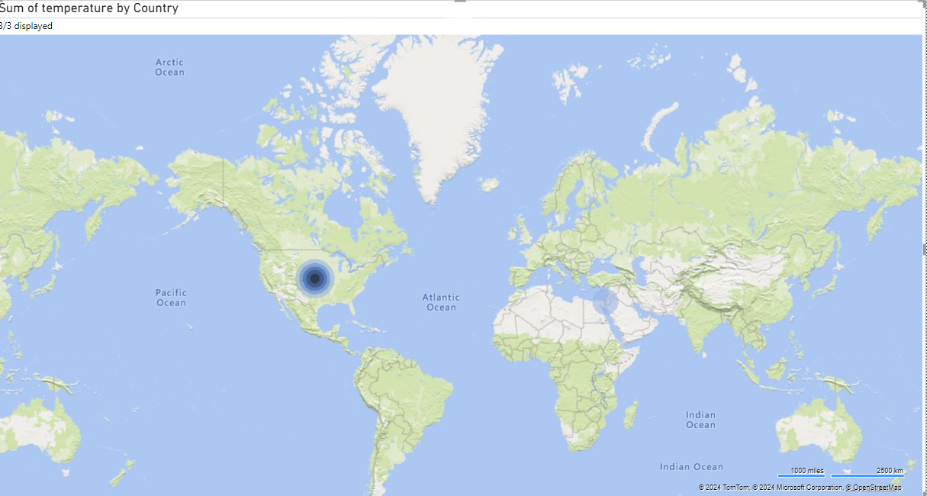
Q11:-Can you build a heatmap in Power BI to show the temperature ranges for cities across different countries?

Slide 17
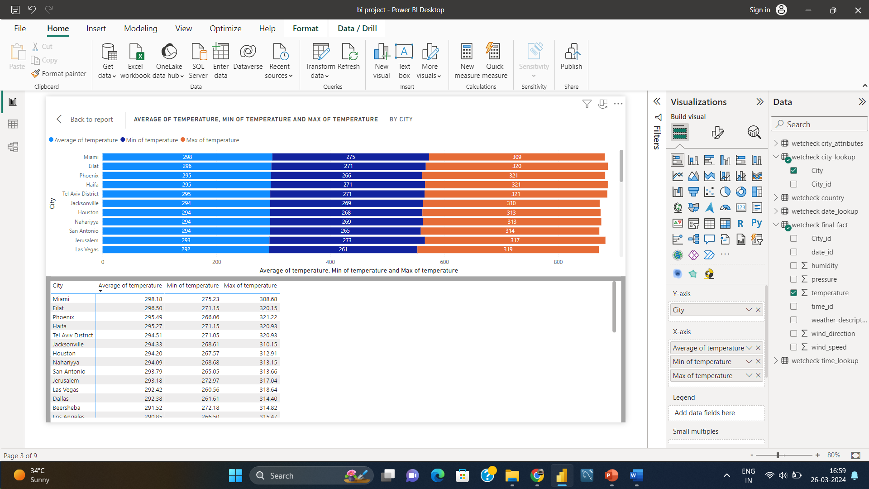
Q.12:-Create a bar chart in Power BI to highlight cities with the highest and lowest average temperatures in the dataset.

Slide 18
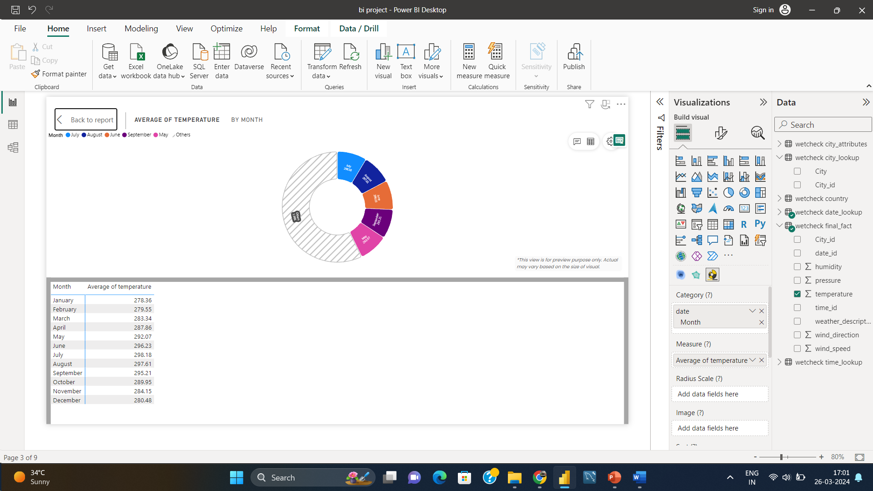
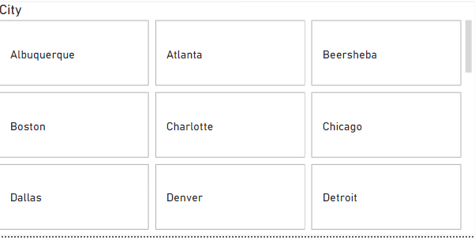
Q13:-Create a wind rose chart in Power BI to visualize the prevailing wind directions for a selected city.

Slide 19
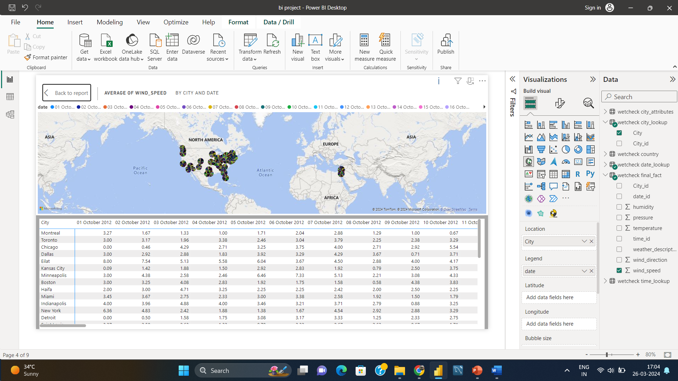
Q14:-Can you generate a Power BI heatmap illustrating the average wind speeds across cities for different months of the year?

Slide 20
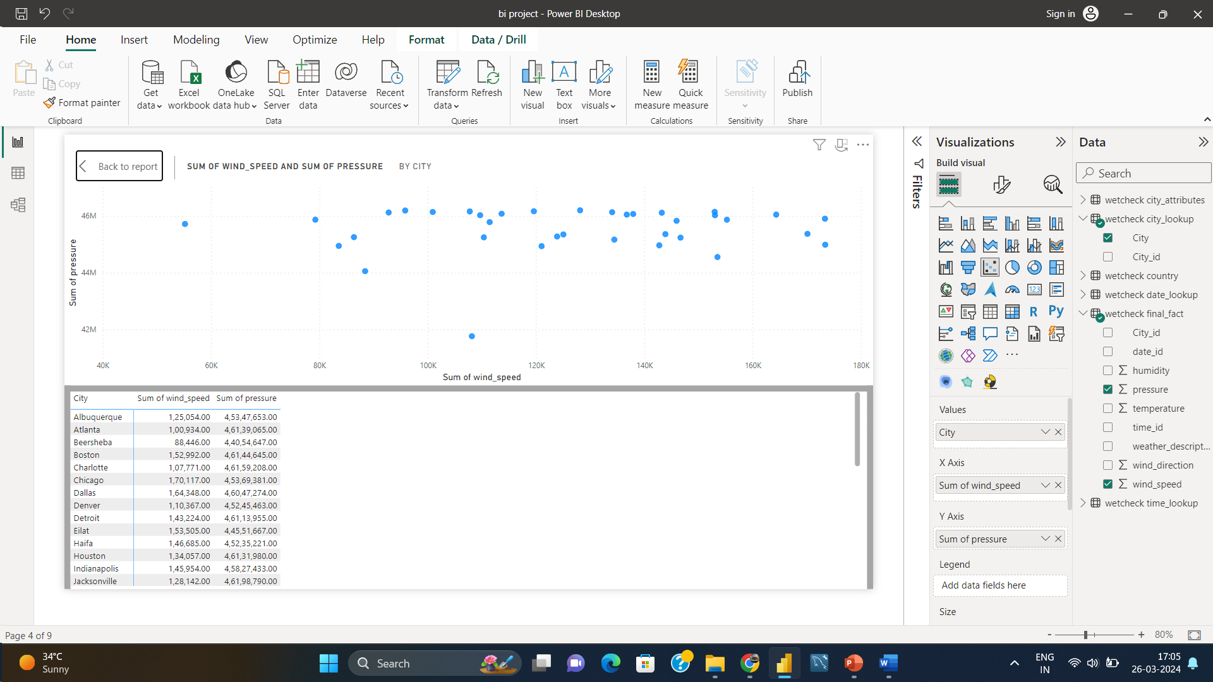
Q15:-Create a Power BI scatter plot to show the relationship between wind speed and air pressure for a specific city.

Slide 21
EDA Analysis

Slide 22
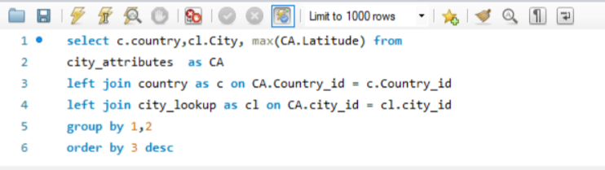
1. Are there any countries with cities located at extreme latitudes, and how might this impact their climate?
Facts :-
The high latitude is situated around the 60° magnetic latitude and higher; the middle latitudes between the 50° and 60° magnetic latitude and everything below the 50° magnetic latitude is considered to be in the category of low latitude.
The higher the altitude, the colder the climate becomes. This is because the air at higher altitudes is less dense and contains less moisture, which makes it more difficult to retain heat
City | Country | max(Latitude)
Vancouver | Canada | 49.24966
Seattle | United States | 47.60621
Portland | United States | 45.52345
Montreal | Canada | 45.50884
Minneapolis | United States | 44.97997
Toronto | Canada | 43.70011
Boston | United States | 42.35843
Detroit | United States | 42.33143
Chicago | United States | 41.85003

Slide 23
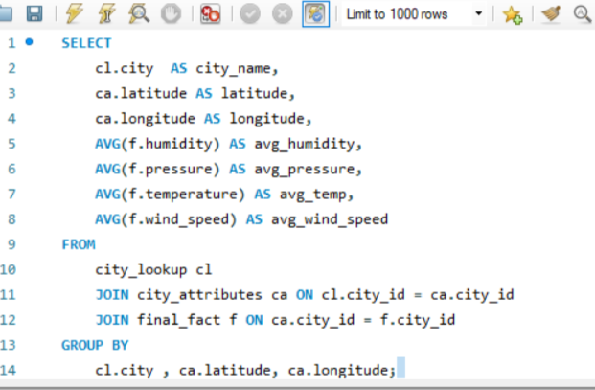
2. Can you identify any clusters of cities with similar latitude and longitude values? What factors might explain these clusters?
city_name | latitude | longitude | avg_humidity | avg_pressure | avg_temp | avg_wind_speed | Range - latitude | Range- longitude
Miami | 25.77 | 80.19 | 75.51 | 1020.23 | 298.18 | 3.24 | 25-28 | 78-81
San Diego | 32.72 | 117.16 | 67.78 | 1017.52 | 290.22 | 1.75 | 29-32 | 114-117
Beersheba | 31.25 | 34.79 | 70.60 | 991.17 | 291.52 | 1.99 | 29-32 | 34-37
Eilat | 29.56 | 34.95 | 53.16 | 1002.04 | 296.50 | 3.45 | 29-32 | 34-37
Haifa | 32.82 | 34.99 | 79.80 | 1017.55 | 295.27 | 3.30 | 29-32 | 34-37
Jerusalem | 31.77 | 35.22 | 68.73 | 1011.03 | 293.18 | 1.88 | 29-32 | 34-37
Tel Aviv District | 32.08 | 34.80 | 66.86 | 1013.82 | 294.51 | 2.72 | 29-32 | 34-37
Jacksonville | 30.33 | 81.66 | 76.44 | 1021.24 | 294.33 | 2.83 | 29-32 | 78-81
Dallas | 32.78 | 96.81 | 64.32 | 1018.90 | 292.38 | 3.63 | 29-32 | 94-97
Houston | 29.76 | 95.36 | 74.07 | 1019.63 | 294.20 | 2.96 | 29-32 | 94-97
San Antonio | 29.42 | 98.49 | 67.70 | 1017.94 | 293.79 | 3.02 | 29-32 | 98-101
Albuquerque | 35.08 | 106.65 | 45.19 | 1012.29 | 285.62 | 2.76 | 33-36 | 106-109
Phoenix | 33.45 | 112.07 | 37.48 | 1013.30 | 295.49 | 1.91 | 33-36 | 110-113
Las Vegas | 36.17 | 115.14 | 31.94 | 1013.66 | 292.42 | 2.46 | 33-36 | 114-117
Los Angeles | 34.05 | 118.24 | 62.77 | 1015.91 | 290.85 | 1.22 | 33-36 | 118-121
Nahariyya | 33.01 | 35.09 | 78.61 | 1015.90 | 294.09 | 3.02 | 33-36 | 34-37
Charlotte | 35.23 | 80.84 | 70.19 | 1020.09 | 288.90 | 2.38 | 33-36 | 78-81
Atlanta | 33.75 | 84.39 | 70.85 | 1020.69 | 289.77 | 2.23 | 33-36 | 82-85
Nashville | 36.17 | 86.78 | 68.24 | 1020.37 | 288.57 | 2.42 | 33-36 | 86-89
Denver | 39.74 | 104.98 | 53.02 | 1011.98 | 282.84 | 2.44 | 37-40 | 102-105
San Francisco | 37.77 | 122.42 | 76.88 | 1018.84 | 288.16 | 2.79 | 37-40 | 122-125
New York | 40.71 | 74.01 | 66.64 | 1017.02 | 285.40 | 3.21 | 37-40 | 74-77
Philadelphia | 39.95 | 75.16 | 68.02 | 1020.25 | 285.37 | 2.64 | 37-40 | 74-77
Pittsburgh | 40.44 | 80.00 | 70.36 | 1019.26 | 284.05 | 2.51 | 37-40 | 78-81
Indianapolis | 39.77 | 86.16 | 72.38 | 1019.20 | 284.77 | 3.23 | 37-40 | 86-89
Saint Louis | 38.63 | 90.20 | 70.60 | 1019.57 | 286.68 | 3.05 | 37-40 | 90-93
Kansas City | 39.10 | 94.58 | 66.63 | 1016.28 | 286.64 | 3.43 | 37-40 | 94-97
Boston | 42.36 | 71.06 | 77.38 | 1019.86 | 283.78 | 3.38 | 41-44 | 70-73
Toronto | 43.70 | 79.42 | 76.36 | 1018.27 | 281.94 | 3.83 | 41-44 | 78-81
Detroit | 42.33 | 83.05 | 72.48 | 1019.14 | 282.97 | 3.17 | 41-44 | 82-85
Chicago | 41.85 | 87.65 | 74.43 | 1018.90 | 283.35 | 3.76 | 41-44 | 86-89
Minneapolis | 44.98 | 93.26 | 71.24 | 1017.44 | 280.70 | 3.38 | 41-44 | 90-93
Portland | 45.52 | 122.68 | 74.70 | 1019.27 | 284.99 | 2.05 | 45-48 | 122-125
Seattle | 47.61 | 122.33 | 77.16 | 1021.00 | 284.41 | 2.12 | 45-48 | 122-125
Vancouver | 49.25 | 123.12 | 81.90 | 1018.13 | 283.86 | 2.43 | 49-52 | 122-125
Montreal | 45.51 | 73.59 | 71.86 | 1016.42 | 280.34 | 3.83 | 45-48 | 70-73
Note :- In the analysis we have added 2 additional column Range- latitude and Range- Longitude for butter cluster
:- Grouped by 5° change in latitude and longitude
As in the analysis we can see that few cities with the similar latitudes and longitude are also have similar humidity , pressure , temprature, wind-speed.

Slide 24
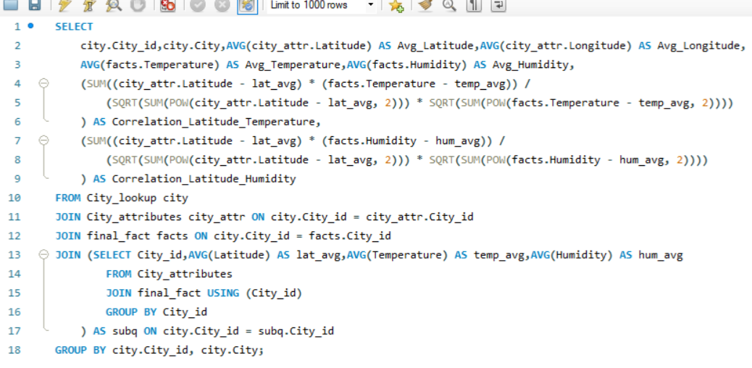
3. Are there any correlations between a city's geographical location (latitude and longitude) and its weather attributes, such as temperature or humidity?
According to analysis cities which are at high latitude generally have low temperature and vice- versa , but humidity is higher at coastal areas

Slide 25
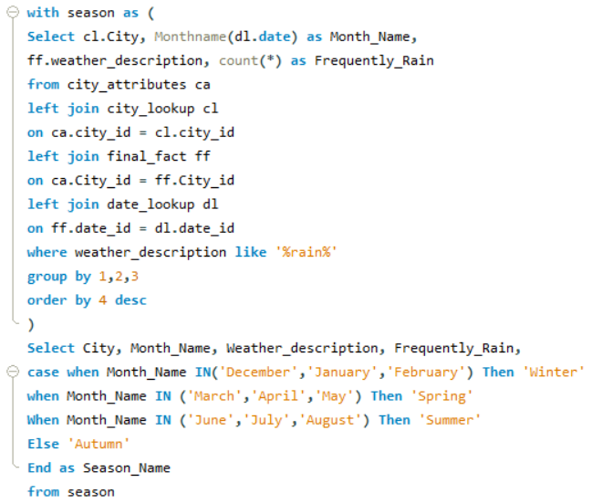
4. Identify the top three cities with the most frequent occurrence of rainy weather based on weather descriptions. What are the seasonal patterns?
As we can identify that top rainy cities are Vancouver ,Seattle, Portland.Seattle, Portland have little less rain in summer season
city | weather_description | frequency | month_ | season
Portland | very heavy rain | 2 | April | Spring
Kansas City | heavy intensity shower rain | 1 | April | Spring
Vancouver | light intensity shower rain | 181 | April | Spring
Albuquerque | light intensity shower rain | 5 | April | Spring
Albuquerque | proximity shower rain | 19 | April | Spring
Toronto | light rain | 388 | April | Spring

Slide 26
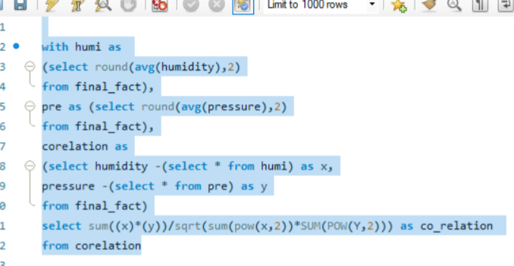
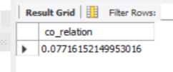
5. Is there a correlation between humidity levels and air pressure? How might this relationship affect weather conditions?
There is a complex relationship between these two factors.It's a very weak positive correlation between humidity and pressure. This means that as humidity increases, pressure tends to increase slightly as well, but the relationship is very weak.

Slide 27
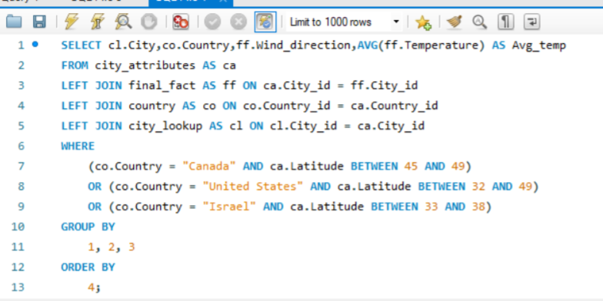
6. Explore the impact of wind direction on temperature for coastal cities. Are there noticeable patterns?
City | Country | Wind_direction | Avg_temp
Montreal | Canada | 360 | 277.2396
Boston | United States | 360 | 277.4433
Albuquerque | United States | 360 | 280.4975
Minneapolis | United States | 360 | 280.7107
Kansas City | United States | 358 | 278.0373
Montreal | Canada | 358 | 280.8966
Kansas City | United States | 357 | 278.9958
Montreal | Canada | 357 | 279.6696
Boston | United States | 357 | 279.6732
Minneapolis | United States | 357 | 280.6145
Detroit | United States | 357 | 280.6979
In My Analyze, the impact of wind direction on temperature in coastal cities by focusing on Canada, the United States and Israel are do not show any relation

Slide 28
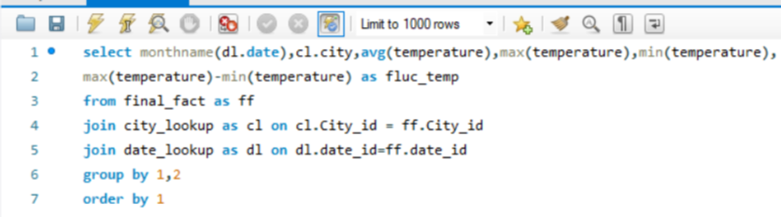
7. Are there specific months when cities experience significant temperature fluctuations? What might explain these variations?
According to analysis the fluctuation in temperature is most in the month of june ,july, aug, and sep
monthname(dl.date) | city | avg(temperature) | max(temperature) | min(temperature) | fluc_temp
April | Albuquerque | 285.6523 | 299.97 | 267.9673 | 32.00267
April | Atlanta | 290.3649 | 302.92 | 272.76 | 30.16
April | Beersheba | 290.9916 | 310.37 | 278.684 | 31.686
April | Boston | 281.9026 | 302.44 | 266.18 | 36.26
April | Charlotte | 289.6289 | 303.2 | 271.15 | 32.05
April | Chicago | 282.1854 | 300.88 | 268.68 | 32.2
April | Dallas | 291.9556 | 305.1 | 275.9 | 29.2
April | Denver | 280.9877 | 298.44 | 259.27 | 39.17
April | Detroit | 281.5397 | 300.64 | 266 | 34.64
April | Eilat | 295.2597 | 313.15 | 281.15 | 32

Slide 29
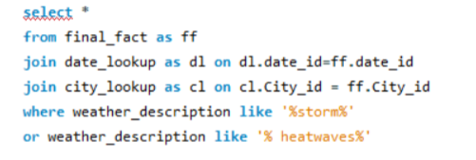
8. Identify periods of extreme weather events, such as storms or heatwaves, by analyzing the time-based data. What patterns emerge?
date_id | time_id | humidity | pressure | temperature | weather_description | wind_direction | wind_speed | date_id | date | City_id | City
7 | 22 | 82 | 1019 | 287.63 | proximity thunderstorm | 290 | 3 | 7 | 07-10-2012 | 3 | San Francisco
9 | 9 | 74 | 1010 | 292.67 | thunderstorm | 310 | 3 | 9 | 09-10-2012 | 3 | San Francisco
19 | 19 | 39 | 1012 | 289.82 | thunderstorm with heavy rain | 0 | 0 | 19 | 19-10-2012 | 3 | San Francisco
72 | 22 | 55 | 1022 | 286.05 | thunderstorm | 60 | 6 | 72 | 11-12-2012 | 3 | San Francisco
72 | 23 | 48 | 1023 | 285.28 | thunderstorm with heavy rain | 0 | 0 | 72 | 11-12-2012 | 3 | San Francisco
12 | 3 | 77 | 1013 | 287.73 | thunderstorm with rain | 0 | 0 | 12 | 12-10-2012 | 5 | Los Angeles
12 | 9 | 40 | 1012 | 293.38 | thunderstorm | 0 | 0 | 12 | 12-10-2012 | 5 | Los Angeles
12 | 21 | 82 | 1011 | 291.01 | proximity thunderstorm | 330 | 4 | 12 | 12-10-2012 | 7 | Las Vegas
12 | 22 | 87 | 1011 | 290.26 | proximity thunderstorm | 330 | 4 | 12 | 12-10-2012 | 7 | Las Vegas
12 | 6 | 82 | 1013 | 289.32 | proximity thunderstorm | 330 | 2 | 12 | 12-10-2012 | 7 | Las Vegas
the effects of extreme weather events are economic costs, loss of human lives, droughts, floods, landslides.

Slide 30
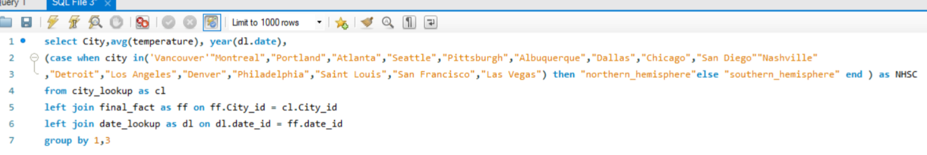
9. Are there any notable differences in temperature trends between northern and southern hemisphere cities over the year? How do they relate to seasons?
City | avg(temperature) | year(dl.date) | NHSC
Vancouver | 283.4070497 | 2013 | southern_hemisphere
Vancouver | 280.4081722 | 2012 | southern_hemisphere
Montreal | 280.1128986 | 2013 | southern_hemisphere
Montreal | 275.8683078 | 2012 | southern_hemisphere
Montreal | 280.1601907 | 2014 | southern_hemisphere
Montreal | 280.1615975 | 2015 | southern_hemisphere
Montreal | 281.8767196 | 2017 | southern_hemisphere
Montreal | 280.6582446 | 2016 | southern_hemisphere
Indianapolis | 284.3850079 | 2013 | southern_hemisphere
Indianapolis | 280.0563175 | 2012 | southern_hemisphere
In the analysis we can see that temperatur in northen and southen hemisohere are different . This provides insights into hemispheric climate variations.
Sum of avg(temperature) | Column Labels
Row Labels | 2012 | 2013 | 2014 | 2015 | 2016 | 2017 | Grand Total
northern_hemisphere | 3961.968329 | 4006.822298 | 4004.345396 | 4010.125207 | 4023.618207 | 4039.765903 | 24046.64534
Albuquerque | 280.7185697 | 285.0525395 | 285.9429092 | 284.6664846 | 285.4078252 | 288.500074 | 1710.288402
Atlanta | 285.1288402 | 288.8575484 | 288.8383276 | 290.2880024 | 290.5397178 | 291.6665795 | 1735.319016
Chicago | 279.7628611 | 283.0920693 | 282.3355757 | 282.2676144 | 284.5166999 | 285.6368021 | 1697.611622
Dallas | 288.2733718 | 292.1079531 | 291.4797968 | 292.2116379 | 293.0667855 | 294.1987773 | 1751.338322
Denver | 278.8732223 | 282.2500082 | 281.5235567 | 282.3073733 | 283.9249177 | 285.4068072 | 1694.285885
Detroit | 279.5749588 | 282.679986 | 281.5899528 | 282.2386137 | 284.2792763 | 285.1048173 | 1695.467605
Las Vegas | 287.8763297 | 292.6246864 | 291.5071189 | 291.0378083 | 293.1468542 | 295.1876219 | 1751.380419
Los Angeles | 289.571963 | 290.3208875 | 290.3932761 | 290.3400054 | 291.4777869 | 292.1283044 | 1744.232223
Philadelphia | 281.0991454 | 285.0519433 | 284.5889509 | 285.3030029 | 286.0106878 | 287.140269 | 1709.193999

Slide 31
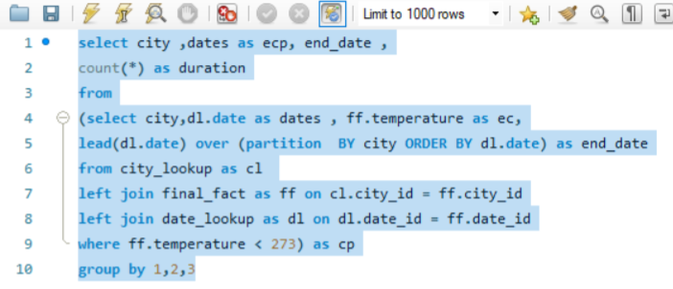
10. What are the consequences of prolonged periods of extreme cold or heat in specific cities? How do residents adapt to such conditions?
city | ecp | end_date | duration
Albuquerque | 27-10-2012 | 28-10-2012 | 1
Albuquerque | 28-10-2012 | 28-10-2012 | 7
Albuquerque | 28-10-2012 | 12-11-2012 | 1
Albuquerque | 12-11-2012 | 12-11-2012 | 12
Albuquerque | 12-11-2012 | 13-11-2012 | 1
Sum of duration | Column Labels
Row Labels | Jan | Feb | Mar | Apr | May | Sep | Oct | Nov | Dec
Albuquerque | 1695 | 851 | 240 | 37 | 12 | 2 | 41 | 667 | 1543
Atlanta | 682 | 406 | 90 | 1 |  |  | 2 | 168 | 180
Beersheba | 9 | 3
Boston | 2019 | 1979 | 1274 | 127 |  |  | 18 | 444 | 964
Charlotte | 873 | 605 | 207 | 5 |  |  | 7 | 271 | 323
Chicago | 2454 | 2236 | 1351 | 107 |  |  | 5 | 828 | 1497
Dallas | 383 | 296 | 93 |  |  |  |  | 82 | 332
Denver | 1973 | 1682 | 923 | 436 | 96 | 10 | 396 | 1070 | 2068
Detroit | 2566 | 2323 | 1647 | 204 |  |  |  | 820 | 1570
According to analysis of the extreme cold or heat on cities. Health conditions of residents , Infrastructure growth and development , Energy utilization and Economic Impact will be a major concern . Residents adapt with appropriate measures. Important for urban planning and well-being.

Slide 32
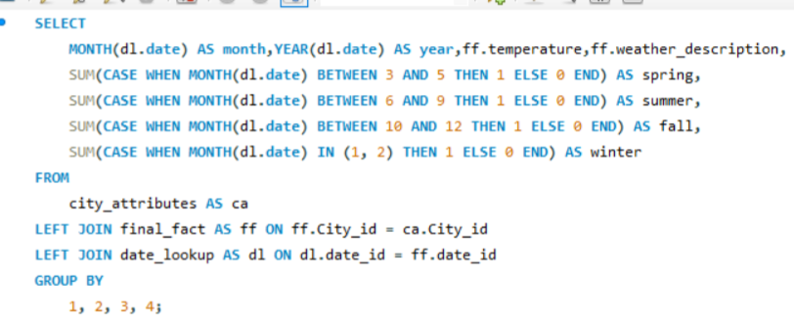
11. Investigate whether temperature anomalies (unusual deviations from the norm) coincide with certain events or environmental factors in specific cities.
Row Labels | Count of temperature | Sum of temperature | Sum of spring | Sum of summer
broken clouds | 136 | 13.60% | 242 | 51
few clouds | 84 | 8.40% | 59 | 64
fog | 2 | 0.20% | 1 | 1
heavy intensity rain | 10 | 0.99% | 7 | 4
light intensity shower rain | 29 | 2.90% | 20 | 11
light rain | 103 | 10.26% | 102 | 67
mist | 21 | 2.08% | 20 | 20
moderate rain | 13 | 1.29% | 11 | 2
overcast clouds | 119 | 11.88% | 281 | 29
proximity shower rain | 11 | 1.10% | 6 | 5
scattered clouds | 113 | 11.28% | 152 | 47
sky is clear | 359 | 36.03% | 1077 | 492
As in the analysis we can I identify that there is a anomalies in temperature and weather description

Slide 33
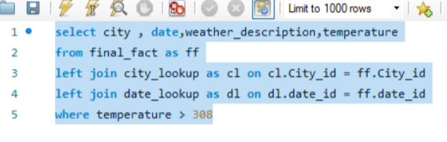
12. Analyze the impact of temperature on energy consumption patterns in cities. Are there noticeable trends or correlations?
Average of temperature | Column Labels
Row Labels | broken clouds | few clouds | haze | light rain | overcast clouds | scattered clouds | sky is clear
Portland | 301.8917 | 303.3086 |  | 301.0075 | 301.282 | 302.6121 | 302.3554
May | 301.3483 |  |  | 300.19 | 300.38 | 300.9675 | 301.4993
Jun | 302.98 | 303.5769 |  | 300.65 | 300.77 | 302.4426 | 302.322
Jul | 301.1692 | 303.6075 |  | 301.7125 | 302.3825 | 302.9084 | 302.6068
Aug | 302.8296 | 302.8394 |  | 300.85 | 300.22 | 302.4586 | 302.2576
Sep |  | 300.8626 |  | 300.83 |  | 301.6472 | 302.0222
Oct |  | 300.46
Vancouver | 300.8212 | 300.8263 | 300.8064 | 301.31 | 301.1033 | 301.4438 | 301.4492
Jun |  | 301.475 |  | 301.31 |  | 300.78 | 301.2085
Temperature above 308 kelvin(35○ Celsius) is consider as high temperature . As increase in temperature will directly effect use of electricity. In these area

Slide 34
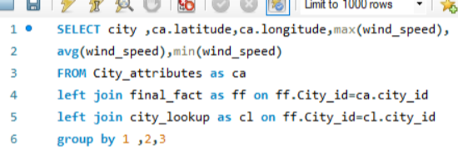
13. How do specific wind patterns impact air quality and pollution dispersion in urban areas? Analyze wind direction data for insights.
Higher wind speeds can effectively disperse pollutants, The direction of the wind determines the flow pattern and distribution of pollutants within a given area

Slide 35
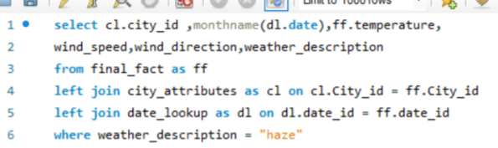
14. Identify cities prone to strong winds and the potential consequences, such as increased risk of natural disasters or challenges for transportation.
Row Labels | Count of wind_speed | Sum of wind_direction | Sum of temperature
Portland | 334 | 64439 | 97397.3
haze | 334 | 64439 | 97397.3
San Francisco | 271 | 41510 | 77340.25
haze | 271 | 41510 | 77340.25
Vancouver | 395 | 78593 | 115429.15
haze | 395 | 78593 | 115429.15
Higher wind speeds generally leads to stome and a natural digesters . And wind speed more than 8 can create challenges for transportation.

Slide 36
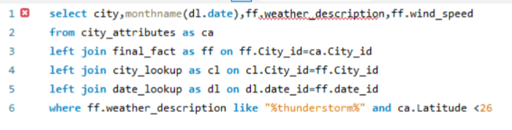
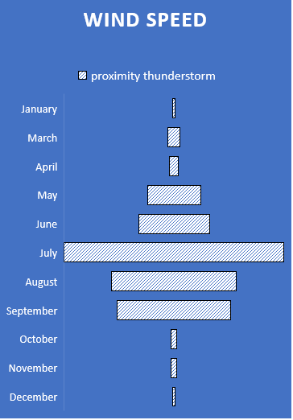
15. Explore whether wind speed and direction influence the frequency and severity of weather-related events (e.g., hurricanes, storms) in coastal cities.
As the analysis shows the coastal ares are majorle effected in the month of july . This can helps improve disaster management and preparedness for hurricanes and storms

Slide 37
Thank You

